Slide 1
Cyclomatic Complexity-

Slide 2
Cyclomatic Complexity-
Cyclomatic Complexity may be defined as-
It is a software metric that measures the logical complexity of the program code.
It counts the number of decisions in the given program code.
It measures the number of linearly independent paths through the program code.
Cyclomatic complexity indicates several information about the program code-

Slide 3
Cyclomatic Complexity | Meaning
1 – 10 | Structured and Well Written Code High Testability Less Cost and Effort
10 – 20 | Complex Code Medium Testability Medium Cost and Effort
20 – 40 | Very Complex Code Low Testability High Cost and Effort
> 40 | Highly Complex Code Not at all Testable Very High Cost and Effort

Slide 4
Importance of Cyclomatic Complexity-
It helps in determining the software quality.
It is an important indicator of program code’s readability, maintainability and portability.
It helps the developers and testers to determine independent path executions.
It helps to focus more on the uncovered paths.
It evaluates the risk associated with the application or program.
It provides assurance to the developers that all the paths have been tested at least once.

Slide 5
Properties of Cyclomatic Complexity-
It is the maximum number of independent paths through the program code.
It depends only on the number of decisions in the program code.
Insertion or deletion of functional statements from the code does not affect its cyclomatic complexity.
It is always greater than or equal to 1.

Slide 6
Calculating Cyclomatic Complexity-
Cyclomatic complexity is calculated using the control flow representation of the program code.
In control flow representation of the program code,
Nodes represent parts of the code having no branches.
Edges represent possible control flow transfers during program execution

Slide 7
There are 3 commonly used methods for calculating the cyclomatic complexity-
Method-01:
Cyclomatic Complexity = Total number of closed regions in the control flow graph + 1
Method-02:
Cyclomatic Complexity = E – N + 2
Here-
E = Total number of edges in the control flow graph
N = Total number of nodes in the control flow graph
Method-03:
Cyclomatic Complexity = P + 1
Here,
P = Total number of predicate nodes contained in the control flow graph

Slide 8
Note-
Predicate nodes are the conditional nodes.
They give rise to two branches in the control flow graph.

Slide 9
Method-01:
Cyclomatic Complexity
= Total number of closed regions in the control flow graph + 1
= 2 + 1
= 3
Method-02:
Cyclomatic Complexity
= E – N + 2
= 8 – 7 + 2
= 3
Method-03:
Cyclomatic Complexity
= P + 1
= 2 + 1
= 3

Slide 10
M = E – N + 2P
where, E = the number of edges in the control flow graph N = the number of nodes in the control flow graph P = the number of connected components

Slide 11
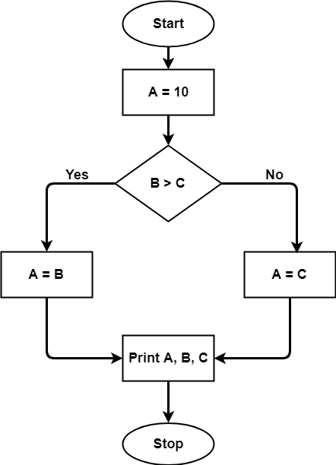
A = 10
IF B > C THEN
A = B
ELSE
A = C
ENDIF
Print A
Print B
Print C
The cyclomatic complexity calculated for above code will be from control flow graph. The graph shows seven shapes(nodes), seven lines(edges), hence cyclomatic complexity is 7-7+2 = 2.

Slide 12
Advantages of Cyclomatic Complexity:.
It can be used as a quality metric, gives relative complexity of various designs.
It is able to compute faster than the Halstead’s metrics.
It is used to measure the minimum effort and best areas of concentration for testing.
It is able to guide the testing process.
It is easy to apply.
Disadvantages of Cyclomatic Complexity:
It is the measure of the programs' control complexity and not the data complexity.
In this, nested conditional structures are harder to understand than non-nested structures.
In case of simple comparisons and decision structures, it may give a misleading figure.

Slide 13
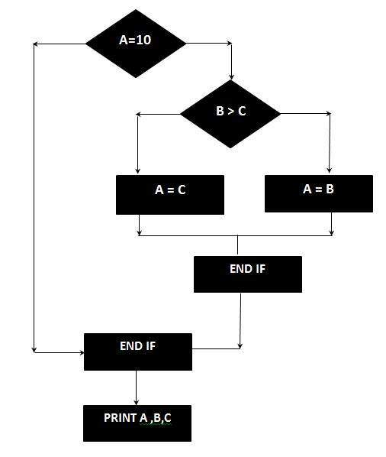

Slide 14
The Cyclomatic complexity is calculated using the above control flow diagram that shows seven nodes(shapes) and eight edges (lines), hence the cyclomatic complexity is 8 - 7 + 2 = 3

Slide 15
Problem-01:
Calculate cyclomatic complexity for the given code-
IF A = 354
THEN IF B > C
THEN A = B
ELSE A = C
END IF
END IF
PRINT A

Slide 16
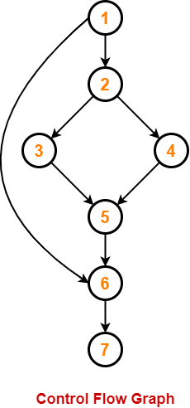
Solution-
We draw the following control flow graph for the given code-

